Slide 1
NLH Update

Slide 2
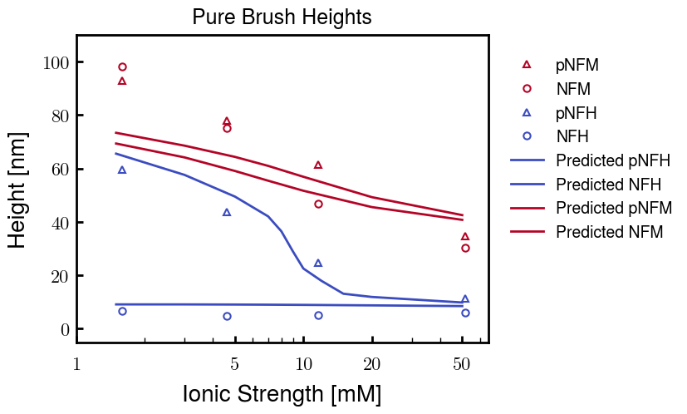
Although the height for pNFM is too short for low Cs, these curves are the best fit

Slide 3
Analysis of other pNFM fitting paramters
b: Kuhn’s monomer length
v: Kuhn’s monomer volume
Degree of coarse graining
Charge of phosphorylated sites
chi: Flory-Huggins parameter (based on amino acid)
Not shown below; made curves worse

Slide 4
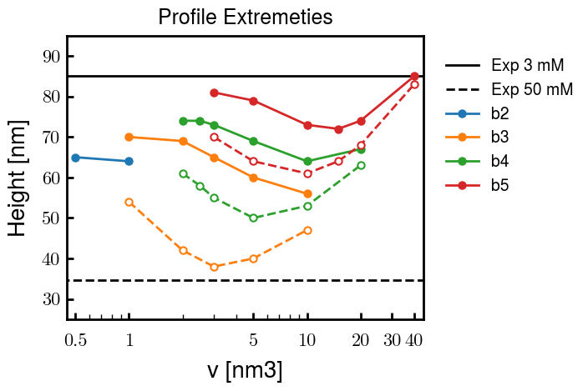
b and v values : Comparison of heights at 3 mM (solid lines) and 50 mM (dashed)
b = 2.0 nm
b = 3.0, v = 2.0 used for results on prev. slide

Slide 5
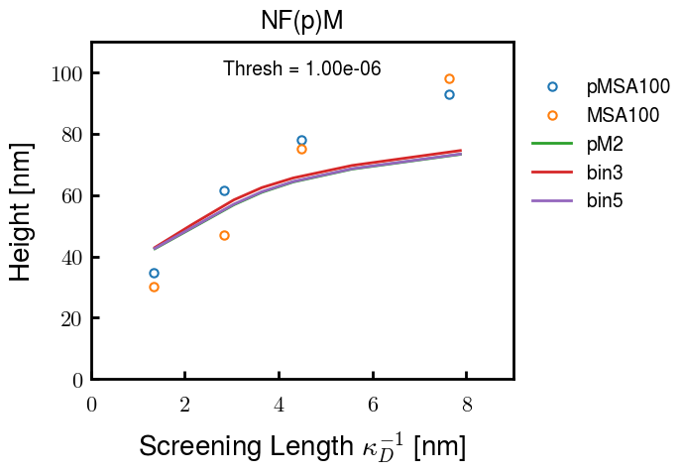
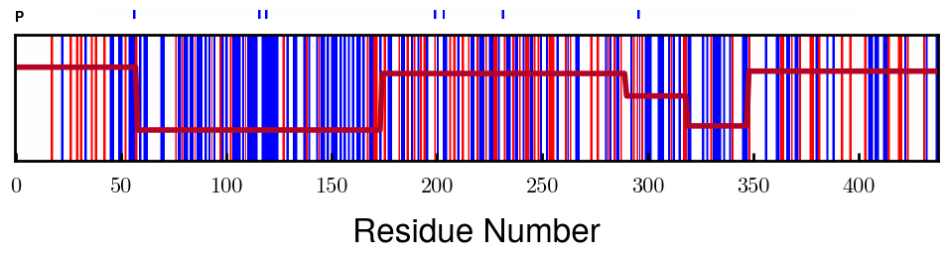
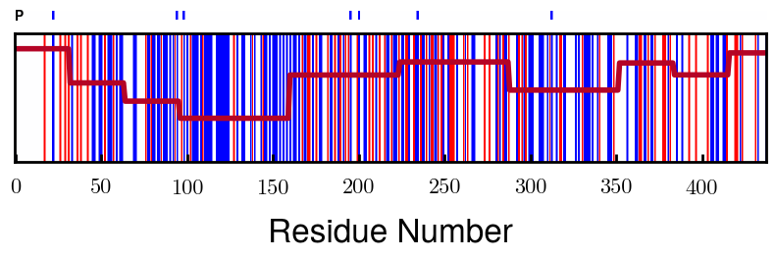
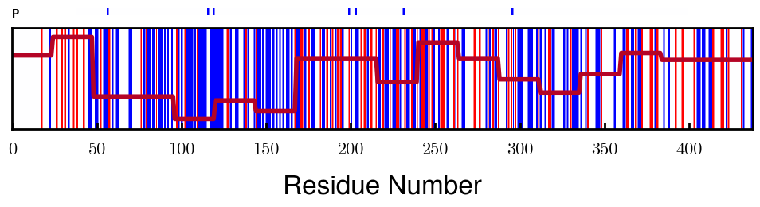
Finer coarse-graining makes little difference
Finer
Note: This is also a demonstration that the coarse-graining is pretty good and finding appropriate the most appropriate blocks

Slide 6
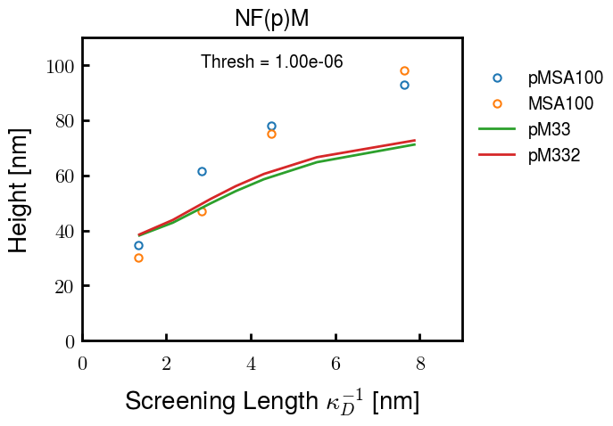
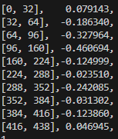
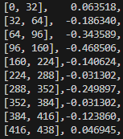
Degree of phosphorylation (-2.0e instead of -1.5e) also similarly little difference (not many units)
Affected blocks

Slide 7
Results
Notes:
b and v values between non- and phosphorylated NFH and NFM are the same; only difference is charge distribution
-1.5e used for charge of phosphorylated sites
Same chi values for each amino acid were used for all results

Slide 8
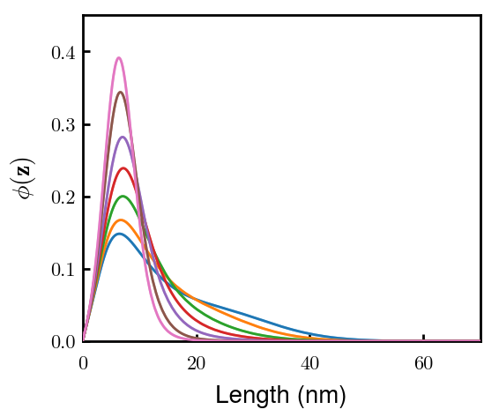
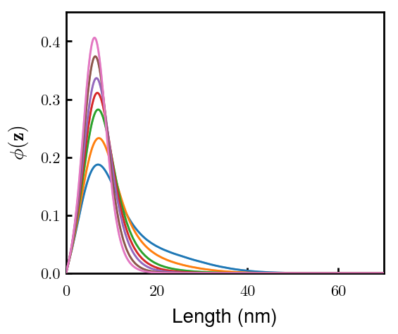
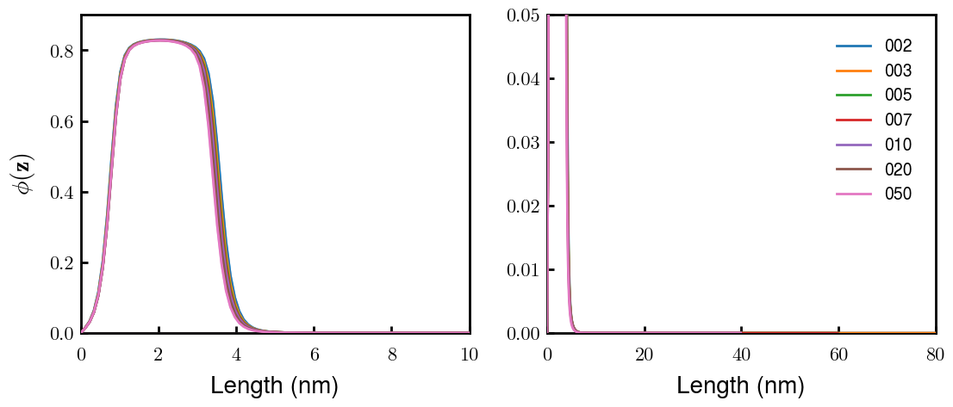
There are no significant differences between pNFM (left) and NFM (right).
mM ionic strength
Stronger shoulder
Very few phosphorylation sites on NFM, leading to little difference

Slide 9
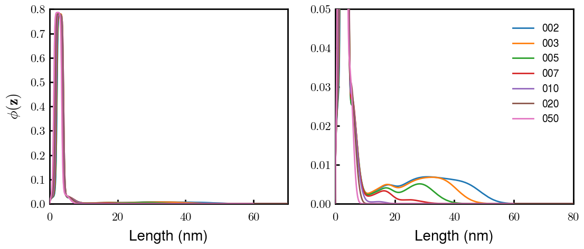
pNFH (left) and NFH (right) are extremely different
In contrast to NFM, NFH has very many phosphorylation sites.

Slide 10
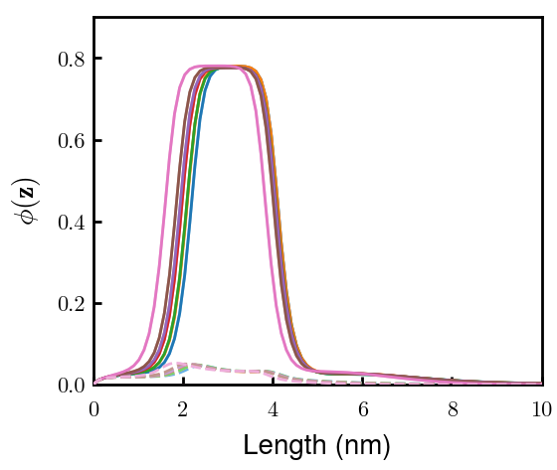
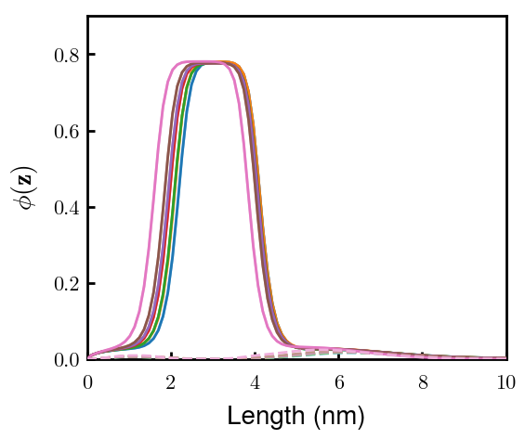
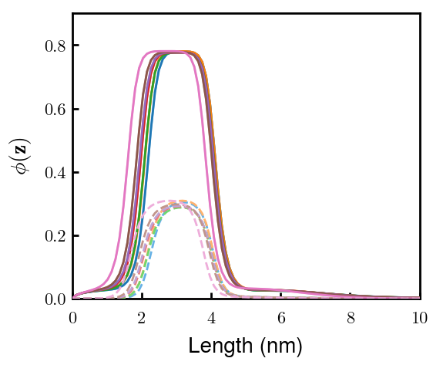
pNFH chains fold back after block 2 to form the inner condensed layer
Block 1
Block 2
Block 3
Remaining look like Block 3

Slide 11
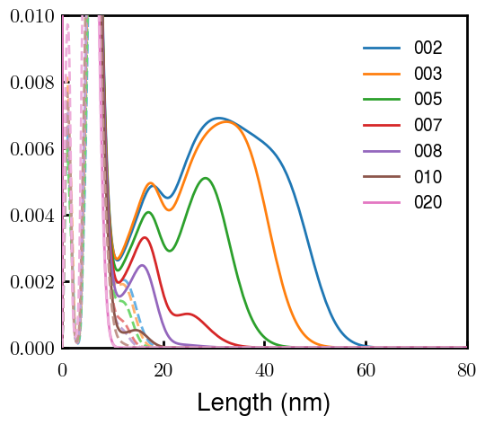
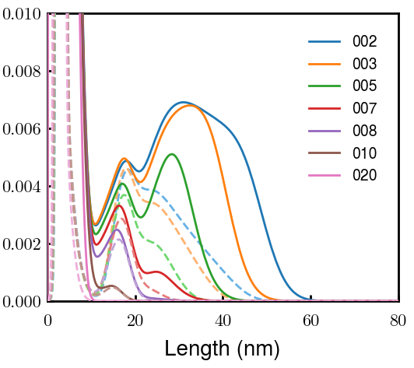
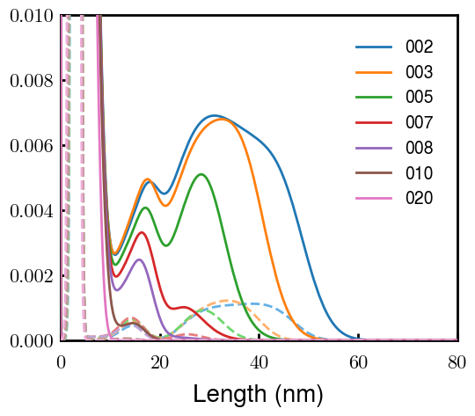
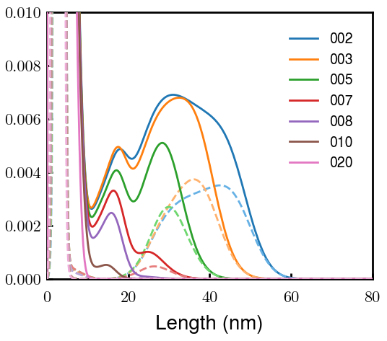
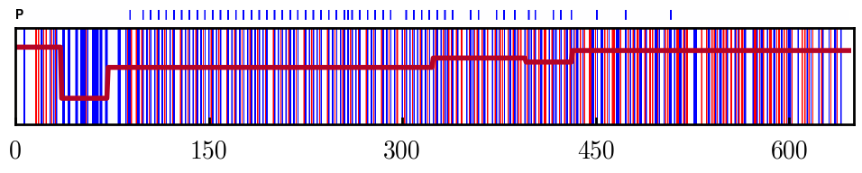
A fraction of pNFH chains do not fold back, forming the outer dilute layer
Block 2
Block 3
Block 4
Block 6
All dilute layers start with a distinct peak formed by Block 3. This is the region of KsP repeats

Slide 12
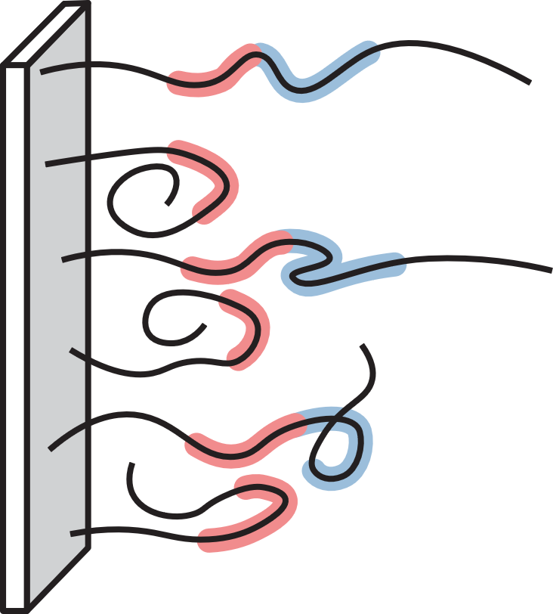
Thus, pNFH chains (at low ionic strengths) look something like this
Block 2
Block 3
2nd Block (red) either folds back or extends
3rd Block (blue) collects at interface between dilute and condensed layers
Crude schematic—I can try to make it look better later

Slide 13
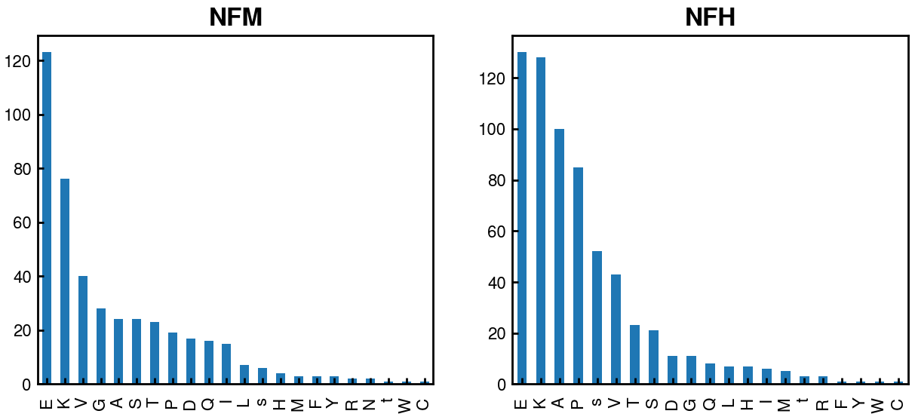
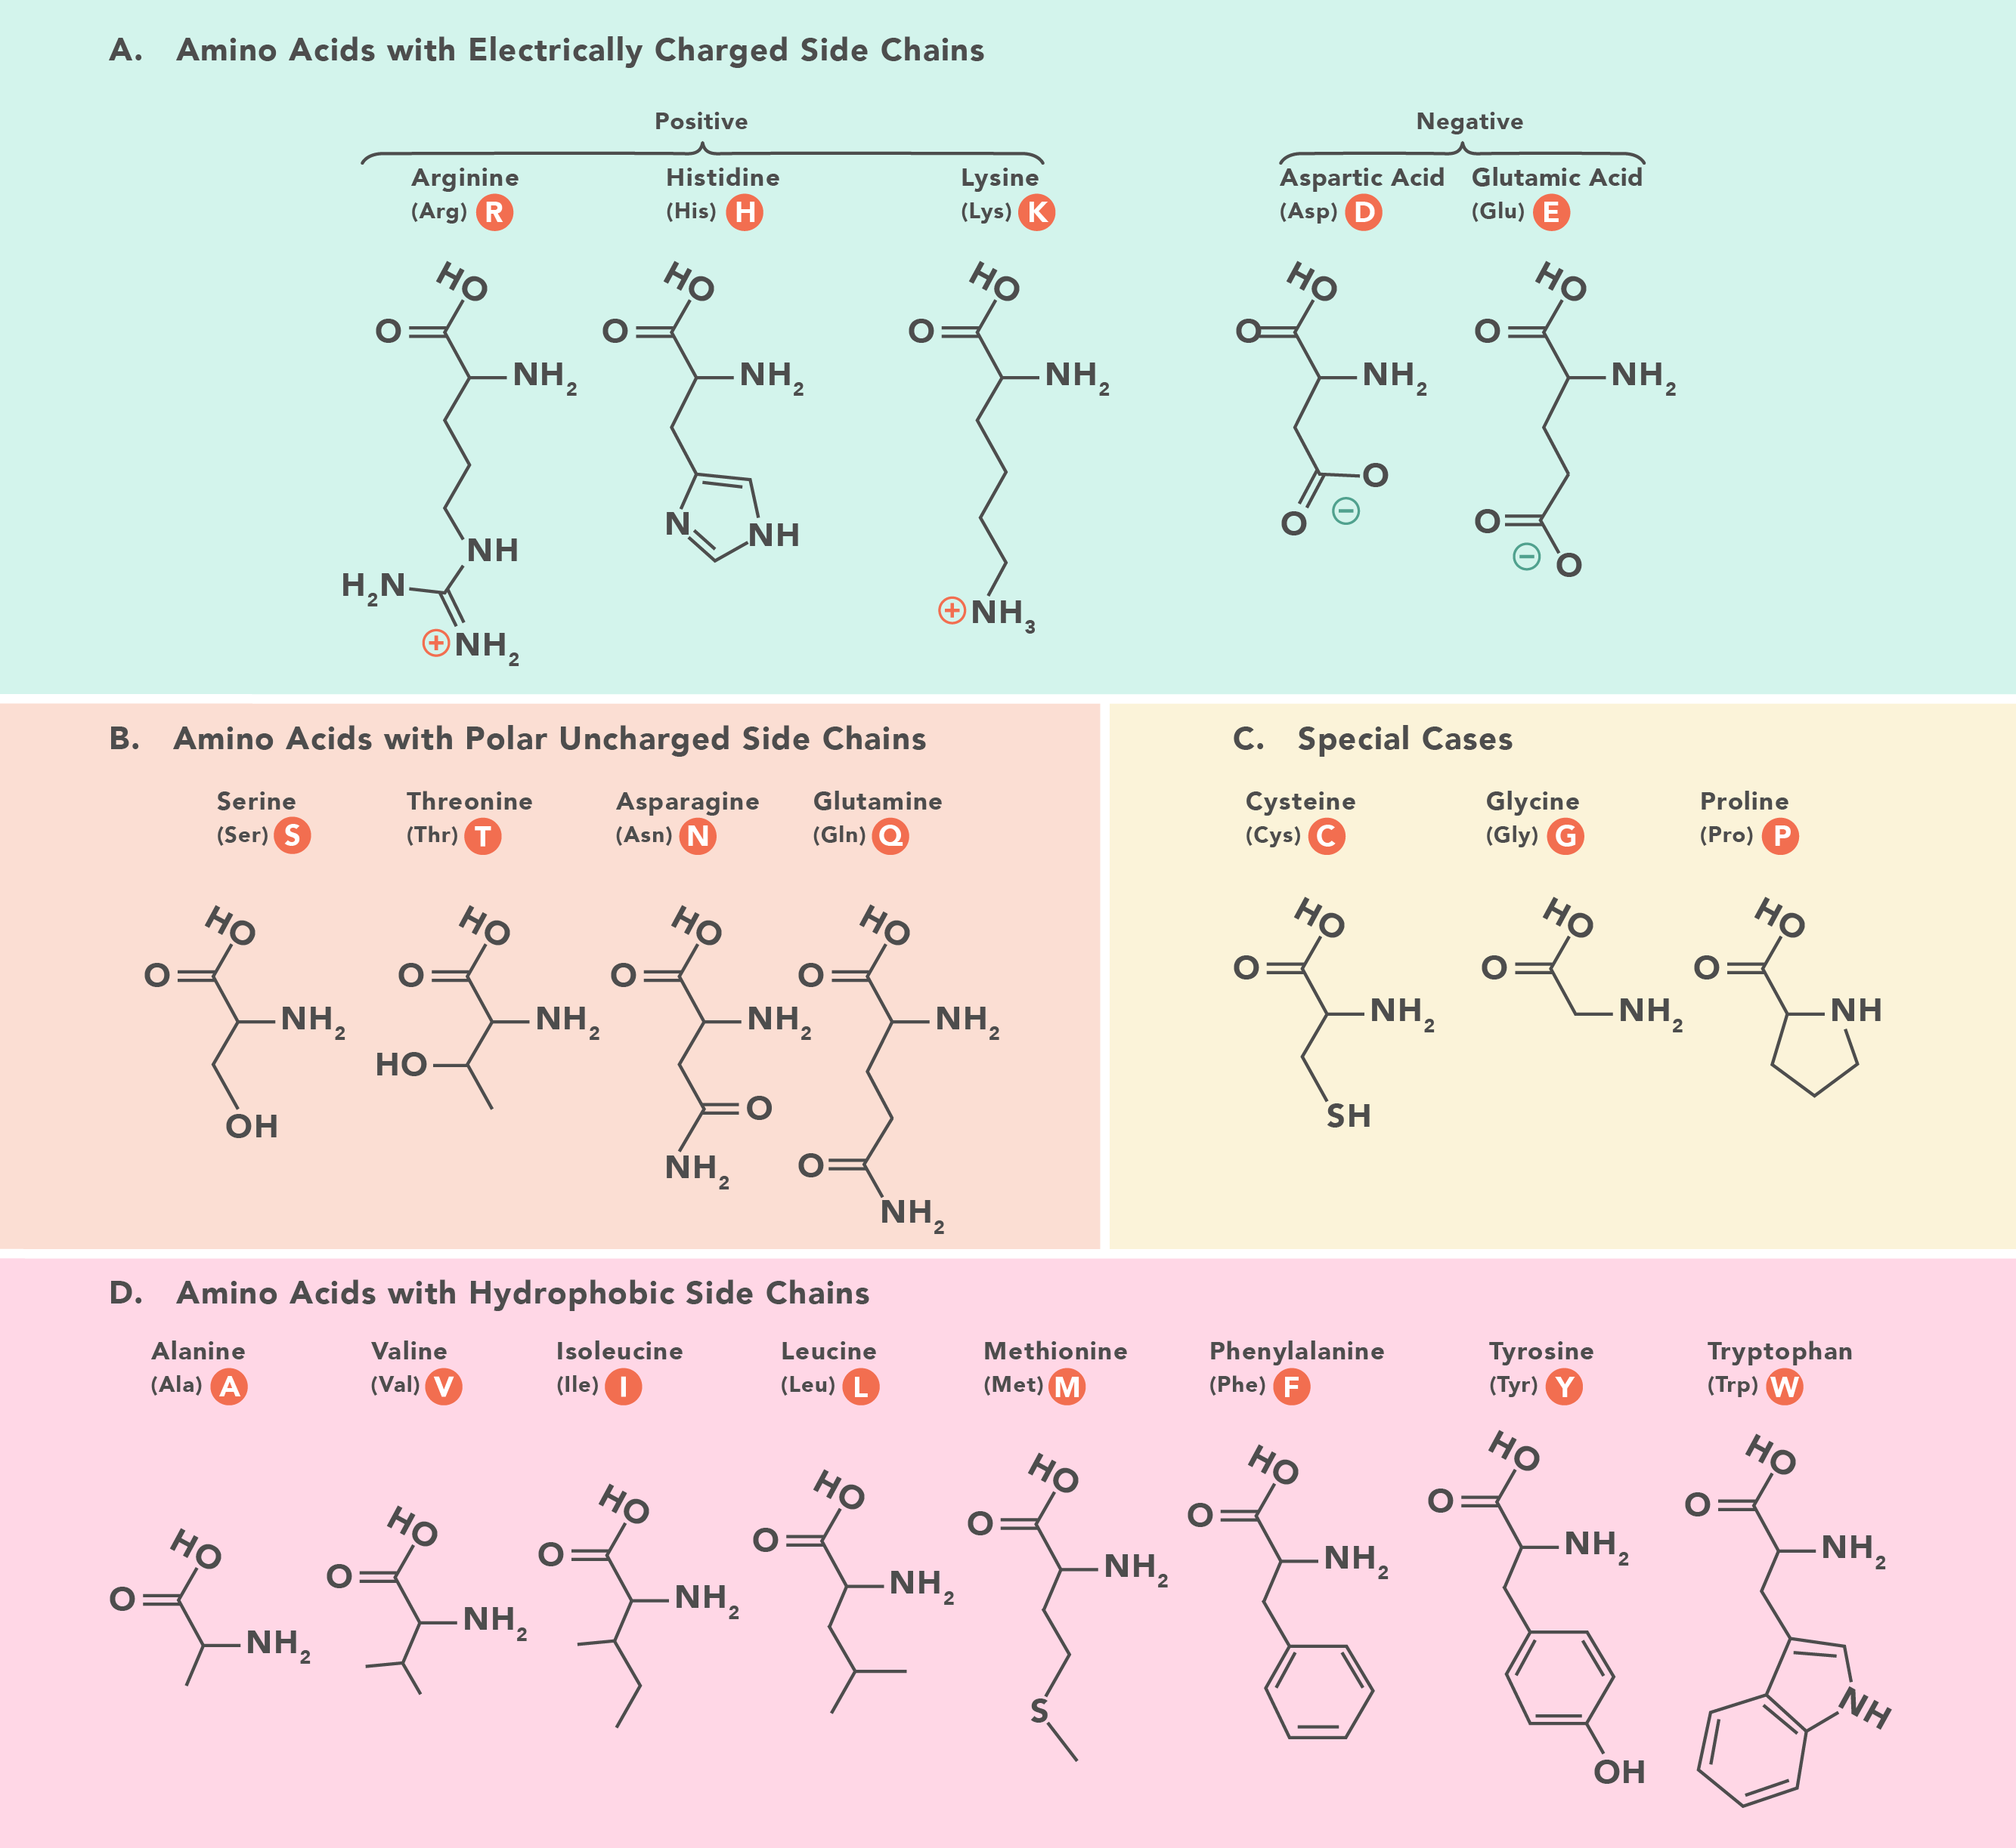
The intrinsic difference between NFM and NFH (besides charge) lies in the chemical structures of the constituent amino acids
Increasing stiffness
b = 4.00 nm
Higher fraction of stiffer residues
b = 0.50 nm
Lower fraction of stiffer residues

